Slide 1


Apache Pekko
Actor Architecture

Slide 2








Apache Pekko Framework Features
A powerful toolkit for building concurrent, distributed, and resilient message-driven applications on the JVM.
Actor System:
Clustering:
Distributed
Hierarchical actor
actor systems across
management with
multiple nodes
supervision
Streams:
Reactive
Fault Tolerance:
Built-in
streams for data
supervision strategies
processing
Persistence:
Event
HTTP:
High-performance
sourcing and CQRS
HTTP server and client
patterns

Slide 3







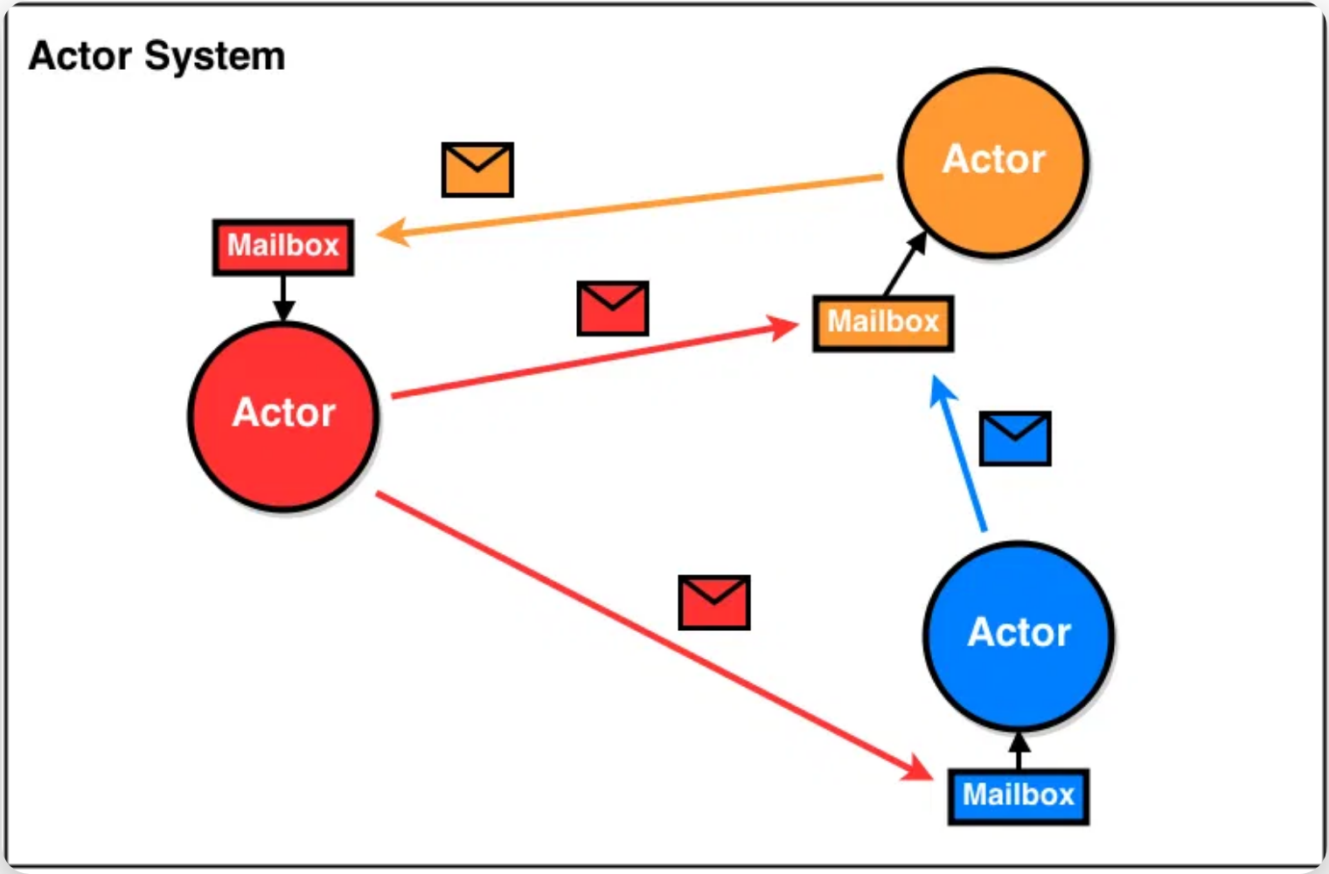

Pekko Actor Architecture & Features
Core Architecture
Advanced Features
Actors are the fundamental building blocks of Pekko's concurrency model.
Pekko provides powerful features for building distributed systems.
ActorSystem:
Hosts multiple actors and manages their
Clustering:
Allows actors to communicate transparently across
lifecycle
multiple nodes
ActorRef:
Reference to an actor, used for sending messages
Supervision:
Hierarchical structure that isolates and recovers
from failures
Mailbox:
Each actor has a mailbox that queues incoming
messages
Event Sourcing:
Support for event-based persistence and CQRS
patterns
Message Patterns:
Support for request-response, pub-sub,
and other patterns

Slide 4




Pekko vs Erlang OTP: Code Comparison
Apache Pekko
Erlang OTP
import org.apache.pekko.actor.typed._
import org.apache.pekko.actor.typed.scaladsl._
object GreeterDemo {
final case class Greet(whom: String, replyTo: ActorRef[Greeted])
final case class Greeted(whom: String)
def greeter: Behavior[Greet] = Behaviors.receiveMessage[Greet] { msg =>
println(s"Hello ${msg.whom}!")
msg.replyTo ! Greeted(msg.whom)
Behaviors.same
}
def replyActor: Behavior[Greeted] = Behaviors.receiveMessage[Greeted] { msg =>
println(s"Received greeting from ${msg.whom}!")
Behaviors.same
}
def main(args: Array[String]): Unit = {
val system = ActorSystem(Behaviors.setup[Any] { ctx =>
val reply = ctx.spawn(replyActor, "reply")
val greeterActor = ctx.spawn(greeter, "greeter")
greeterActor ! Greet("Roger", reply)
Behaviors.empty
}, "HelloSystem")
}
}
-module(erlang_greeter_demo).
-behaviour(gen_server).
-export([init/1, handle_info/2, start/0]).
init(reply_actor) -> {ok, reply_actor};
init(greeter) -> {ok, greeter}.
handle_info({greet, Whom, ReplyPid}, greeter) ->
io:format("Hello ~s!~n", [Whom]),
ReplyPid ! {greeted, Whom},
{noreply, greeter};
handle_info({greeted, Whom}, reply_actor) ->
io:format("Received greeting from ~s!~n", [Whom]),
{noreply, reply_actor}.
start() ->
{ok, ReplyPid} = gen_server:start_link({local, reply_actor},
?MODULE, reply_actor, []),
{ok, GreeterPid} = gen_server:start_link({local, greeter},
?MODULE, greeter, [ReplyPid]),
GreeterPid ! {greet, "Roger", ReplyPid},
ok.
Key Differences
Type System:
Pekko has strong typing, Erlang is
API Style:
Pekko uses Behavior patterns, Erlang
Runtime:
Pekko runs on JVM, Erlang on BEAM
dynamically typed
uses callbacks
virtual machine

Slide 5





Key Code Differences: Pekko vs Erlang
Strong typing
with compile-time checks
Pekko
Dynamic typing
with pattern matching
Erlang
final case class Greet(whom: String,
replyTo: ActorRef[Greeted])
def greeter: Behavior[Greet] =
Behaviors.receiveMessage[Greet] { msg =>
// Type-safe message handling
}
handle_info({greet, Whom, ReplyPid}, greeter) ->
% Pattern matching for message type
% No compile-time type checking
{noreply, greeter};
Type System
Behavior patterns
with functional approach
Pekko
Callback functions
with OTP behaviors
Erlang
def replyActor: Behavior[Greeted] =
Behaviors.receiveMessage[Greeted] { msg =>
println(s"Received greeting from ${msg.whom}!")
Behaviors.same // Return next behavior
}
-behaviour(gen_server).
init(reply_actor) -> {ok, reply_actor};
handle_info({greeted, Whom}, reply_actor) ->
io:format("Received greeting from ~s!~n", [Whom]),
{noreply, reply_actor};
API Style
Spawn with context
and typed references
Pekko
Start with gen_server
and process IDs
Erlang
val system = ActorSystem(Behaviors.setup[Any] { ctx =>
val reply = ctx.spawn(replyActor, "reply")
val greeterActor = ctx.spawn(greeter, "greeter")
greeterActor ! Greet("Roger", reply)
Behaviors.empty
}, "HelloSystem")
start() ->
{ok, ReplyPid} = gen_server:start_link(
{local, reply_actor}, ?MODULE, reply_actor, []),
{ok, GreeterPid} = gen_server:start_link(
{local, greeter}, ?MODULE, greeter, [ReplyPid]),
GreeterPid ! {greet, "Roger", ReplyPid},
ok.
Actor Creation
Pattern matching
on typed messages
Pekko
Pattern matching
in callback functions
Erlang
def greeter: Behavior[Greet] =
Behaviors.receiveMessage[Greet] { msg =>
println(s"Hello ${msg.whom}!")
msg.replyTo ! Greeted(msg.whom)
Behaviors.same
}
handle_info({greet, Whom, ReplyPid}, greeter) ->
io:format("Hello ~s!~n", [Whom]),
ReplyPid ! {greeted, Whom},
{noreply, greeter};
Message Handling

Slide 6


Apache Pekko: Pros & Cons
Advantages
Challenges
Strong Type Safety
Steep Learning Curve
Catches errors at compile time rather than runtime
Actor model requires different thinking about concurrency
JVM Integration
Debugging Complexity
Access to vast Java/Scala ecosystem and tools
Asynchronous message flow can be harder to trace
Built-in Supervision
Resource Overhead
Ready-to-use fault tolerance strategies
JVM requires more memory than lightweight alternatives
Comprehensive Framework
Testing Challenges
Includes clustering, streams, persistence, and HTTP
Testing concurrent systems requires specialized approaches

Slide 7


Key Takeaways
Apache Pekko provides a robust implementation of the Actor Model for building concurrent, distributed systems
Pekko's Actor architecture offers state isolation, asynchronous communication, and supervision hierarchy
Pekko offers strong type safety and JVM integration, facilitating the development of resilient systems
Apache Pekko: Building resilient, message-driven applications

Slide 8


References & Further Reading
Actor Model History
Erlang OTP Resources
Carl Hewitt et al. (1973) - "A Universal Modular ACTOR Formalism for AI"
Erlang/OTP - gen_server Behavior
Documentation for Erlang's gen_server behavior
The original paper introducing the Actor Model
Learn You Some Erlang - What is OTP?
Apache Pekko Documentation
Comprehensive guide to understanding Erlang OTP
Apache Pekko - Actor Reference Documentation
Official documentation for Pekko's Actor implementation
Apache Pekko - Getting Started Guide
Tutorial for building your first Pekko application

